Slide 1
Community Asset Mapping
May 26, 2011

Slide 2
Objectives
To provide methods on how to conduct CAM
To share how CAM can benefit coalition development.
To provide CAM resources

Slide 3
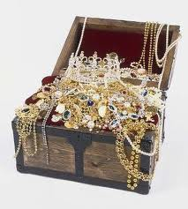
Definition
Community Asset Mapping (CAM)
Notes:
Provides the foundation for assessing gaps and making improvements; provides a collective inventory of positive and valued aspects of a community, including places, institutions, programs and people.

Slide 4
General Benefits of CAM
Recognize resources
Forge relationships
Strengthen power base

Slide 5
Using Community Asset Mapping to Strengthen Coalitions
Identifies gaps
Strengthens local effort
Expands opportunities for inclusion
Supports CX process

Slide 6
Types
Individual
Associations
Institutions
Businesses
Community

Slide 7
Individual
Skills
Talents
Experiences
Consider
Personal
Professional
Resources
Leadership

Slide 8
Associations
Association Name
Contact person
Contact information
Examples
Business – Neighborhood, Chamber of Commerce, Diabetes, YMCA, YWCA, Urban League

Slide 9
Institutions

