Slide 1
Model Ordinance Language for Smokefree Success
Maggie Mahoney, JD
Tobacco Control Legal Consortium
www.tclconline.org
Bronson Frick
Americans for Nonsmokers’ Rights
www.no-smoke.org

Slide 2


The Tobacco Control Legal Consortium
A national legal network supporting tobacco control policy change.
Notes:
For beginning section, when I describe our role - why we were involved with helping ANR.

Slide 3

What We Do:
Policy development
Legal research, analysis, and interpretation
Education and training
Litigation support
Notes:
Goes with previous slide

Slide 4
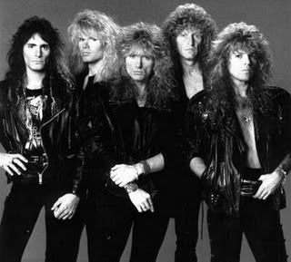
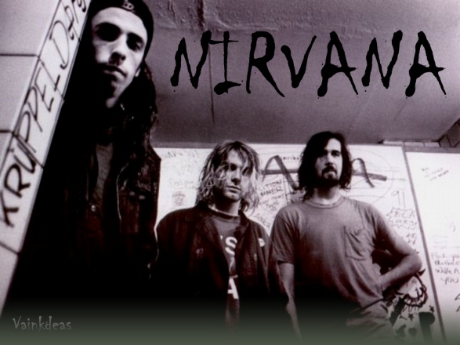

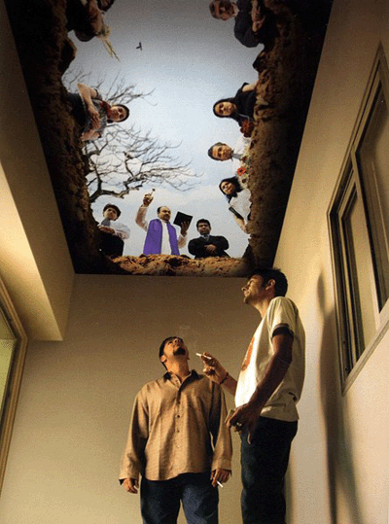

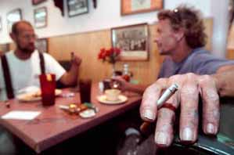
1980s 1990s 2000 & beyond
Smoking Sections Smoking Rooms 100% Smokefree
Notes:
We have come along way, both in hairstyles and in effective smokefree policy standards
These moves were supported by a combination of public demand and the science on the health effects of secondhand smoke.

Slide 5
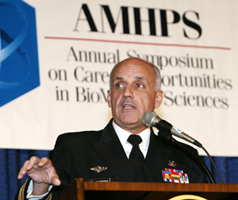
2006 Surgeon General’s Report
There is no risk-free level of exposure to secondhand smoke.
Ventilation of the air cannot eliminate all the health risks caused by exposure to secondhand smoke.

Slide 6
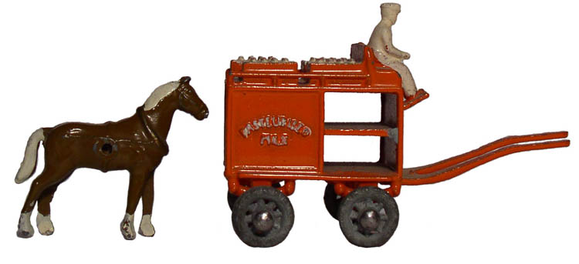
Plan before you act
Notes:
Our primary goal is to reduce and eliminate disease and death
Legislation is not the primary goal, but a tool to change the cultural climate.

Slide 7
Guiding Principles
Plan before you act
Agree on “Dealbreakers”
Be realistic about resources
Start with a strong grassroots base
Start with model policy language
Include expert advisors
Importance of broad-based community support
Notes:
Several states now have state-specific versions of the Fundamentals document, endorsed at the board –level of coalition partner organizations, which makes it easier to have consistently strong policy expectations throughout a state. Having an intake process for new partners to sign onto something like this is also important. This system helps ensure policy discipline, mutual accountability to the policy goal, including organizations that may not be as familiar with smokefree. If a group is speaking on behalf of a coalition, it is vital they are on board with the collective agreement to good policy, rather than “just getting something passed” that may not achieve the health goal or even create a barrier to future progress – like preemption.

Slide 8
Examples of Policy Dealbreakers
Preemption
Ventilation/Smoking Rooms
Hours/Age Restrictions
Signage (Red-Light, Green-Light)
Grandfather Clauses
Exemptions – Where to draw the line?

Slide 9
Agree on Dealbreakers & Key Principles Early in Process
Put decisions in writing
Notes:
This process of consensus building can take a while, but it is time well-spent for avoiding mis-steps later in the policy process. There is a difference between publicly announced Fundamentals/Guiding Principles/Key Dealbreakers vs. a coalition’s more confidential deliberations around provisions of potential negotiation. ANR has some exercise charts that coalitions can use for this process.

Slide 10
ANR Model Ordinance
http://no-smoke.org/document.php?id=229
Key Updates:
Definitions
E-Cigs
Restaurant/Bar patios
Penalties/Enforcement
Issues to Watch:
100% smokefree hotels (WI)
Medical marijuana SHS
Other emerging issues

Slide 11
Electronic Cigarettes
Enforcement issues and findings; not a tobacco product
"E-cigarette" - any electronic oral device, such as one composed of a heating element, battery, and/or electronic circuit, which provides a vapor of nicotine or any other substances, and the use or inhalation of which simulates smoking. The term shall include any such device, whether manufactured, distributed, marketed, or sold as an e-cigarette, e-cigar, e-pipe, or under any other product name or descriptor.
"Smoking" means inhaling, exhaling, burning, or carrying any lighted or heated cigar, cigarette, or pipe, or any other lighted or heated tobacco or plant product intended for inhalation, in any manner or in any form. "Smoking" also includes the use of an e-cigarette which creates a vapor, in any manner or in any form, or the use of any oral smoking device for the purpose of circumventing the prohibition of smoking in this Article.
Notes:
To insert after Bronson discusses e-cigarettes

Slide 12
Other Definitions, such as:
"Enclosed Area" means all space between a floor and a ceiling that is bounded on all sides by walls, doorways, or windows, whether open or closed. A wall includes any retractable divider, garage door, or other physical barrier, whether temporary or permanent.
"Place of Employment" means an enclosed area under the control of a public or private employer . . . . (Sec. 1005 prohibits smoking “in all enclosed areas of places of employment without exception.”)
Notes:
To add after Bronson talks about definitions, generally.

Slide 13
Proprietors’ Duties
Sec. 1011. Posting of Signs and Removal of Ashtrays
The owner, operator, manager, or other person in control . . . shall:
[P]ost "No Smoking" signs . . . in that place.
[P]ost at every entrance to that place a sign stating that smoking is prohibited.
[P]ost on every vehicle that constitutes a place of employment . . . at least one sign . . . stating that smoking is prohibited.
Remove all ashtrays from any area where smoking is prohibited by this Article, except for ashtrays displayed for sale and not for use on the premises.
Sec. 1013. Enforcement
. . . An owner, manager, operator, or employee of an establishment regulated by this Article shall direct a person who is smoking in violation of this Article to extinguish the product being smoked. If the person does not stop smoking, the owner, manager, operator, or employee shall refuse service and shall immediately ask the person to leave the premises. If the person in violation refuses to leave the premises, the owner, manager, operator, or employee shall contact a law enforcement agency. . . .
Notes:
To add, after Bronson talks about proprietors’ duties and enforcement.

Slide 14
Thank you
Maggie Mahoney, JD
Tobacco Control Legal Consortium
www.tclconline.org
Bronson Frick
Americans for Nonsmokers’ Rights
www.no-smoke.org
Notes:
Here’s my contact info to put on Bronson’s final slide. I’d like to have my name on the intro slide, too.

