Slide 1
The Devil is in the Details:
Case Study from NC’s Smokefree Restaurant and Bars Law
Prepared for TCN
June 2010
Sally Herndon and Jim Martin

Slide 2
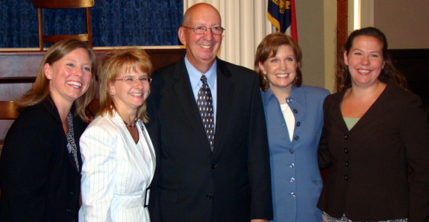
Celebrating Success in North Carolina!!
Winston-Salem Journal
By James Romoser and John Hinton
May 14, 2009
RALEIGH -- Smoking will be outlawed in every restaurant and bar in North Carolina starting early next year.
After months of vigorous debate, the N.C. General Assembly gave final approval yesterday to a bill that marks a historic break with the state's long and lucrative tobacco legacy. It makes North Carolina the first major tobacco-producing state to pass such a restrictive ban on smoking.

Slide 3
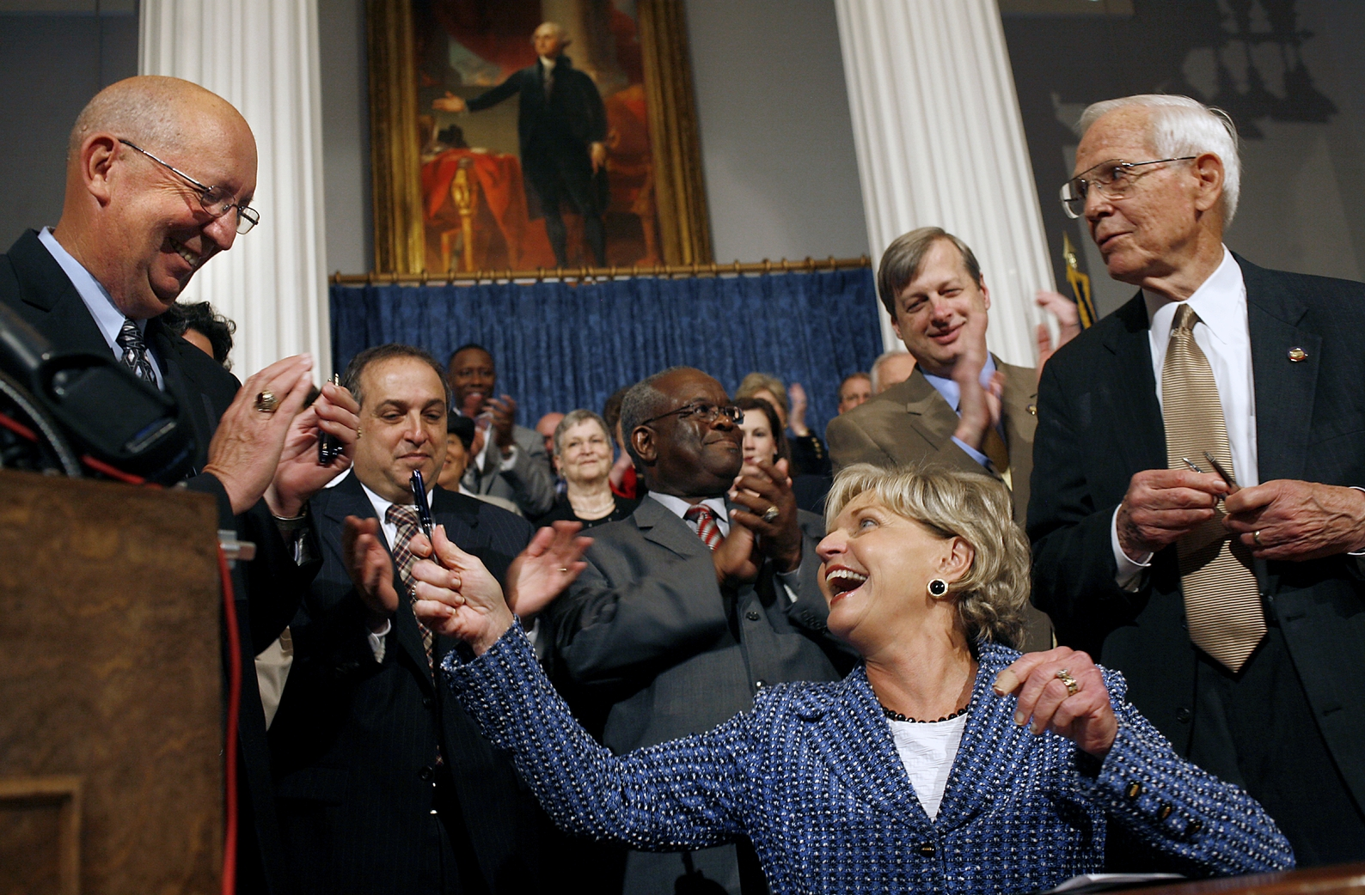
If NC can celebrate smokefree restaurants and bars, so can we all!
Photo Credit: Ted Richardson
News and Observer
Notes:
Slide - Bill Signing was a CELEBRATION
Photos and thank you’s

Slide 4
NC’s Smoke free Restaurants and Bars Law Monthly Number of Unique Complaints* & Businesses**
* Monthly statewide number of complaints reporting a business with a potential violation of the law
** Monthly statewide number of businesses named in one or more complaint(s) of a potential violation of the law

Slide 6

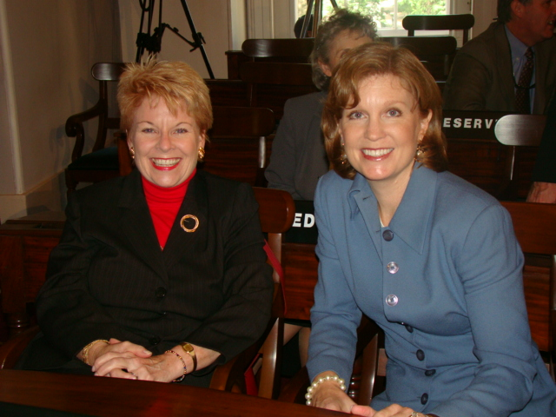
How did we do it?
Make sure you have a broad based coalition that agrees upfront on provisions that are NOT acceptable and should not be included in your regulations (e.g., ventilation, hours or minors provisions).
“Make incremental progress without closing doors on future progress”

Slide 7

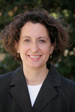


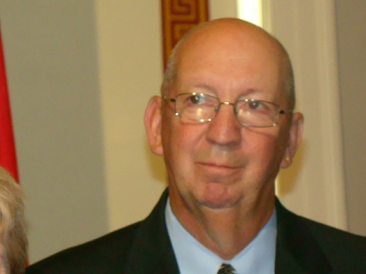
Call on technical and legal experts!
Amend the model language to reflect the correct terms and definitions that are applicable in your city or state.
And then make sure your primary sponsors
are on board!

Slide 8
“The debate is over”: This is about protecting worker health
Assure that the intent or purpose of the law/ordinance is strong and clear.
Findings: The General Assembly finds that secondhand smoke has been proven to cause cancer, heart disease, and asthma attacks in both smokers and nonsmokers. In 2006, a report issued by the United States Surgeon General stated that the scientific evidence indicates that there is no risk free level of exposure to secondhand smoke.
Intent: It is the intent of the General Assembly to protect the health of individuals in public places and places of employment and riding in state government vehicles from the risks related to secondhand smoke. It is further the intent of the General Assembly to allow local governments to adopt local laws governing smoking within their jurisdictions that are more restrictive than state law.

Slide 9


Avoid using ambiguous or contradictory language.
A person in charge of a restaurant, bar,
or lodging establishment that is subject to the new law must:
  Post the required no-smoking signs in conspicuous locations.
  Remove indoor ashtrays and other smoking receptacles.
  Direct any person who is smoking to extinguish the cigarette, cigar, or other item.

Slide 10
Watch out for EXEMPTIONS!
Avoid granting exemptions for particular places, which are inconsistent with the objectives or purpose of the state law/ordinance.
Bars
Adult venues
Private clubs (broadly defined)
Cigar bars (broadly defined)
Hookah bars

Slide 11
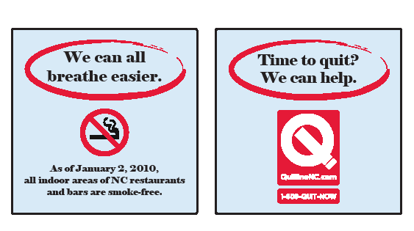
Educate, Educate, Educate
Assure that the law or ordinance fosters clear implementation and enforcement. This includes delineating and empowering the enforcement authority. In many states, more details can be adopted through administrative rules for state laws.

Slide 12
NO
SMOKING
-Indoors-
G.S. 130A-497
1-800-662-7030 www.smokefree.nc.gov
Require that the website address and/or toll free number for registering complaints are prominently listed on the no smoking signage. (Thank you, Ursula Bauer!)
Notes:
DPH recommends this sign as in the proposed rules. The 1-800 number and website will help educate the public and the businesses about the law.
The proposal for the size of the signs is 4”x6”
TPCB will provide the signs, plus it can be downloaded on www.smokefree.nc.gov

Slide 13
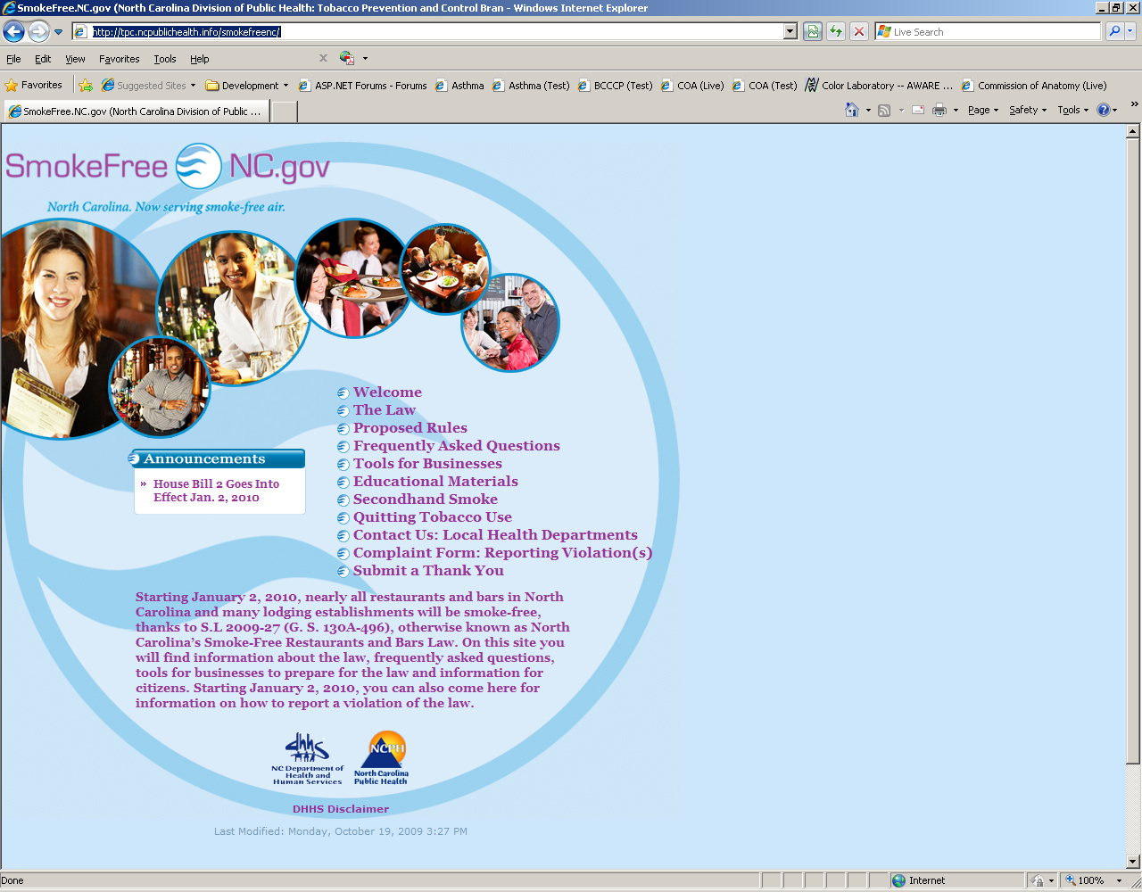
Assure that the effective date of the law allows enough time for educational efforts, administrative rules process.
www.smokefree.nc.gov

Slide 14
Webinar Series:
Implementing NC’s Smokefree Restaurant and Bars Law:
What Local Health Directors Need to Know
What Local Health Department Staff Need to Know
What County and City Attorneys Need to Know
UNC School of Government
NC DHHS, Division of Public Health
September 18, 2009
September 29, 2009
November 18, 2009
Notes:
14
Welcome! My name is Aimee Wall and I am a faculty member here at the UNC School of Government. I am very pleased to be here with you today to launch this new series of webinars designed to help local governments implement the new statewide smoking law. This series is the result of a collaboration between the UNC School of Government and the Division of Public Health within the North Carolina Department of Health and Human Services. We would like to thank Americans for Nonsmokers Rights for providing grant funding to the Division of Public Health to support this webinar series. Because of this generous grant, we are able to offer these webinars to local government officials free of charge.
Before we get started, I would like to take a moment to review a couple of technical details.
First – QUESTIONS: please feel free to submit your questions at any time. Simply type them into the box on the left side of your screen. We plan to respond to questions periodically throughout the webinar so please keep them coming! We probably will not have time to respond to all questions but we need to know what is on your mind. Your questions will help guide our planning for the upcoming webinars and will also help us identify additional FAQs that need to be drafted for the website.
Second, TECHNICAL DIFFICULTIES: On the left hand side of your screen, you will see a link to a troubleshooting website and a phone number for technical assistance. Please use them if you need to. If you are having trouble hearing the audio presentation, the best solution is usually to call into the webinar and listen over the phone. If you are having trouble viewing the slides, you may want to try exiting and reentering the webinar to see if that resolves the problem.
OKAY, I think that takes care of our housekeeping matters. Let’s get started...
14

Slide 15
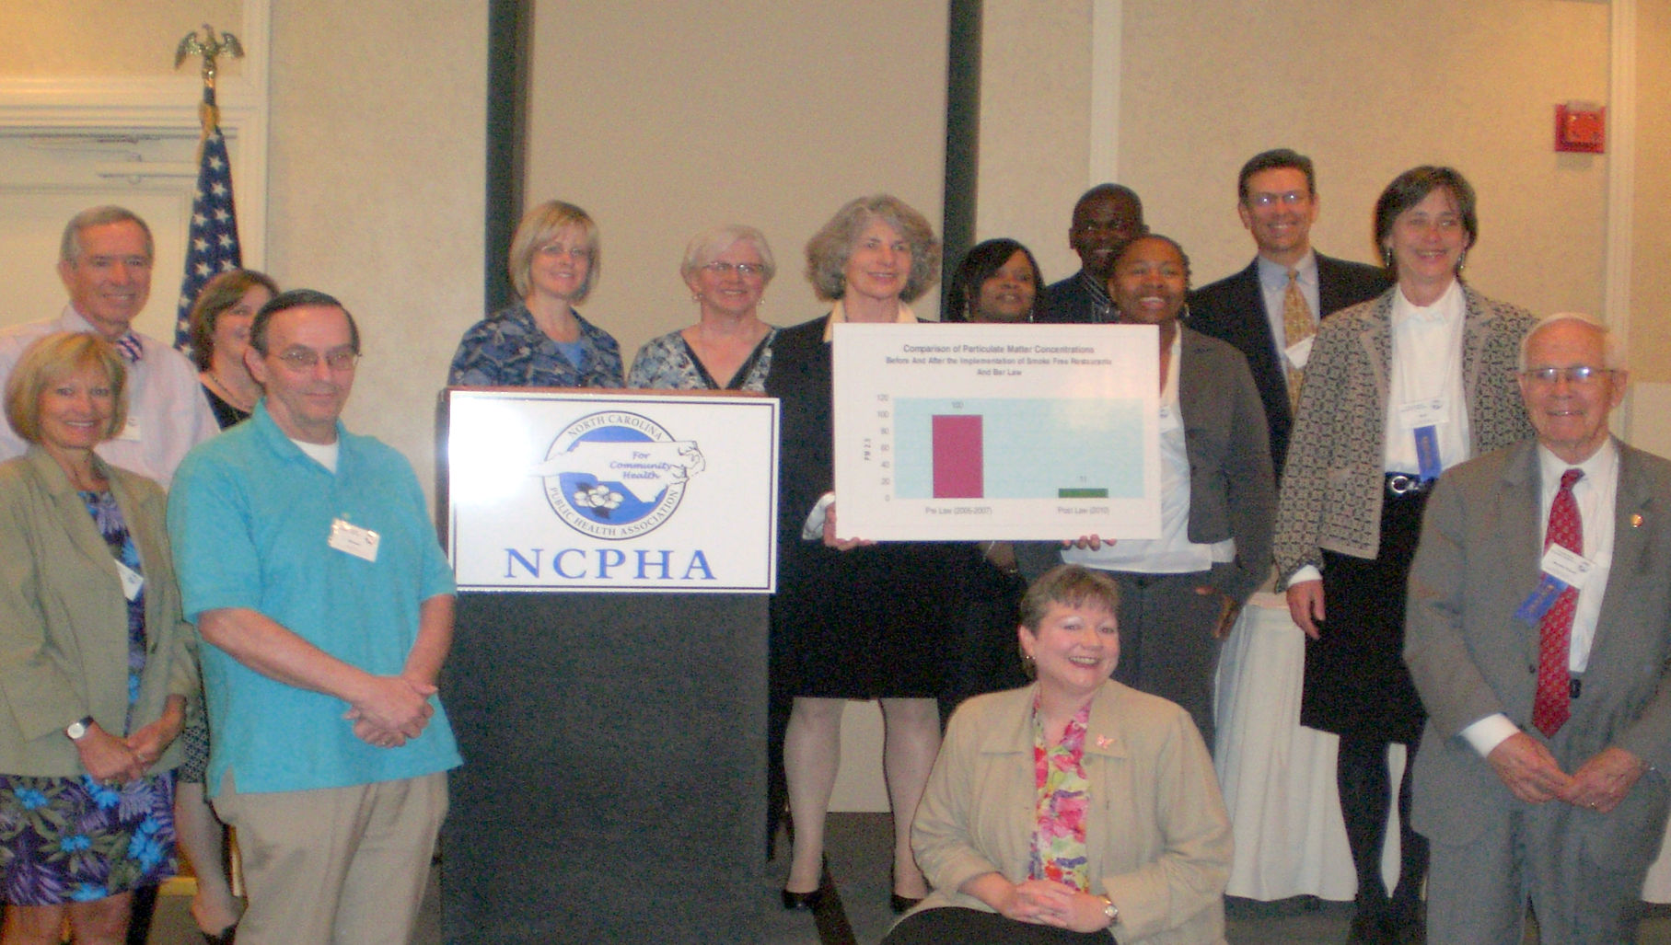
89% Improvement in air quality in NC bars and restaurants

Slide 16
10 Take Home Lessons
Learn from the national partners and those states that have gone before. (Call on us!)
Build a coalition built on trust and strategic communication.
Assure that your coalition agrees upfront on provisions that are NOT acceptable and should not be included in your regulations (e.g., ventilation, hours or minors provisions). Have a crisis communications plan in place in the event of a threat or opportunity.
Assure that the intent or purpose of the law/ordinance is strong and clear.
Amend the model language to reflect the correct terms and definitions that are applicable in your city or state.
Avoid using ambiguous or contradictory language.
7. Avoid granting exemptions for particular places, which are inconsistent with the objectives or purpose of the state law/ordinance.
8. Assure that the law or ordinance fosters clear implementation and enforcement. This includes delineating and empowering the enforcement authority. In many states, more details can be adopted through administrative rules for state laws. Educate, educate, educate.
9. In a complaint driven system, require that the website address and/or toll free number for registering complaints are prominently listed on the no smoking signage.
10. Assure that the effective date of the law allows enough time for educational efforts, administrative rules process.

Slide 17
QUESTIONS?
Need assistance? We are at your service!
Sally Herndon MPH
Sally.Herndon@dhhs.nc.gov
919-707-5401
Clarify law or data requirements?
Jim D. Martin, MS
Jim.Martin@dhhs.nc.gov
919-707-5404
Help with media or messaging?
Ann Staples
Ann.Staples@dhhs.nc.gov
704-543-2347
Help with local implementation or local ordinances?
Elisabeth Constandy, MA
Elisabeth.Constandy@dhhs.nc.gov
910-790-6007
Legal questions: Start with staff above who have access to
Chris Hoke, JD
Chief, Regulatory Affairs, DPH
Chris.Hoke@dhhs.nc.gov
919-707-5006
Thank you!
Notes:
17

